Slide 1


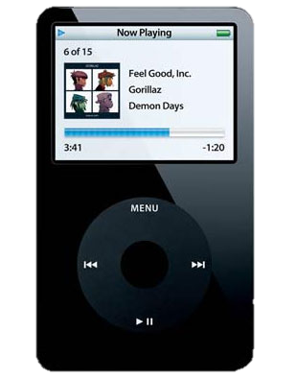



OCG
Notes:
Icon

Slide 2
■
►
►►I
I◄◄
Notes:
Rockstar Gold Components 1

Slide 3
■
►
►►I
I◄◄
Notes:
Rockstar Gold Components 2

Slide 4
■
II
►►I
I◄◄
Notes:
Rockstar Gold Components 3

Slide 5
■
II
►►I
I◄◄
Notes:
Rockstar Gold Components 4

Slide 6
Notes:
Freezed Blue Components 1

Slide 7
Notes:
Freezed Blue Components 2

Slide 8
Notes:
Freezed Blue Components 3

Slide 9
Notes:
Freezed Blue Components 4

Slide 10
Notes:
Freezed Blue Components 5

Slide 11
Notes:
Freezed Blue Components 6

Slide 12
Notes:
Freezed Blue Components 7

Slide 13
Notes:
Freezed Blue Components 8

Slide 14
Notes:
Freezed Blue Components 9

Slide 15
Notes:
Freezed Blue Components 10

Slide 16
Notes:
Freezed Blue Components 11

Slide 17
File
Media
Tools
Help
Now Playing:
Once Upon A Time In Mumbaai – Tum Jo Aaye
Notes:
Dark Direction Preview

Slide 18

ANIco.in
?

